Slide 1
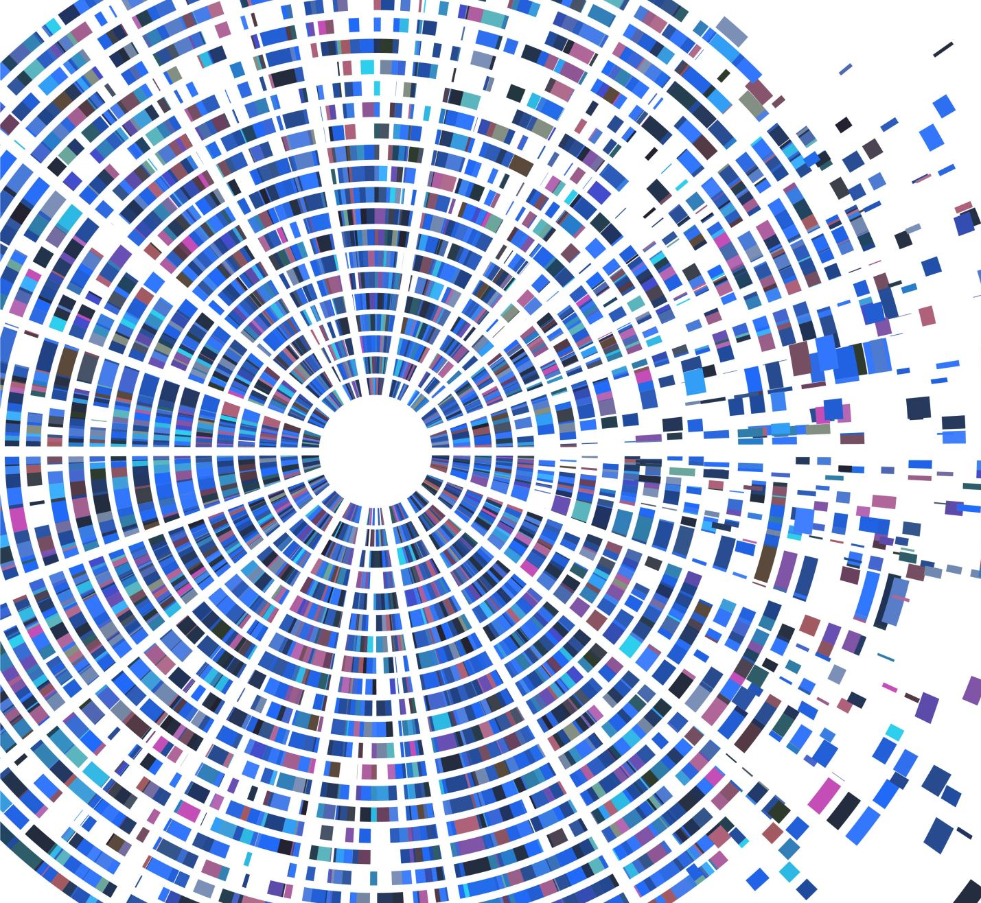
Predicting Car Accident Severity

Slide 2
Predicting car accidents severity is valuable for Seattle Drivers
This report will target those driving around Seattle
Therefore drivers will drive more carefully or even change travel if they able to.
Will try to detect collisions that occur around the city
Possibility of getting into a car accident
Severity of the accidents
Insurance companies have interest as well

Slide 3
Data acquisition and cleaning
Seattle Collision data downloaded from Coursera Applied Data Science Capstone
The data is also found at provided by Seattle Police Department and recorded by Traffic Records https://data-seattlecitygis.opendata.arcgis.com/
In total, 19,4673 rows and 38 features in the raw dataset
Irrelevant features, rows containing irrelevant or missing data were dropped
Cleaned data contains 4 features

Slide 4
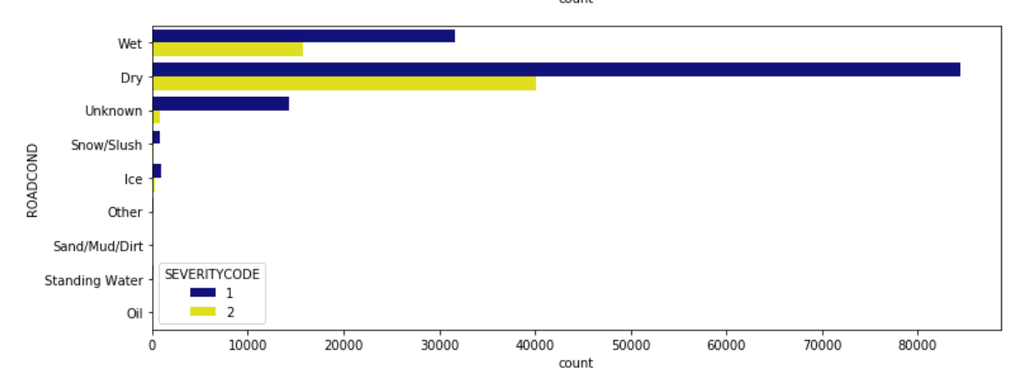
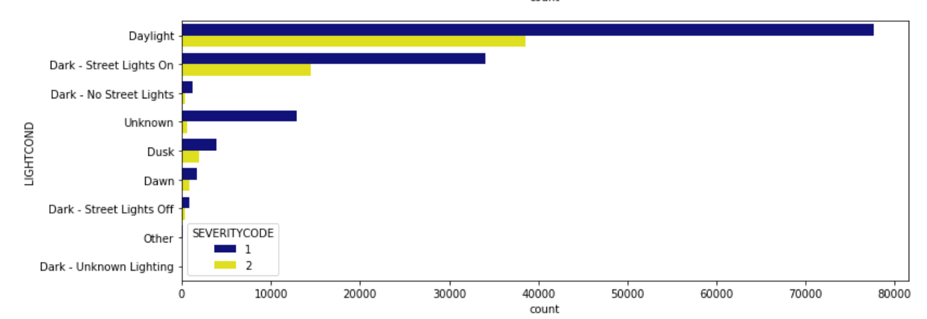
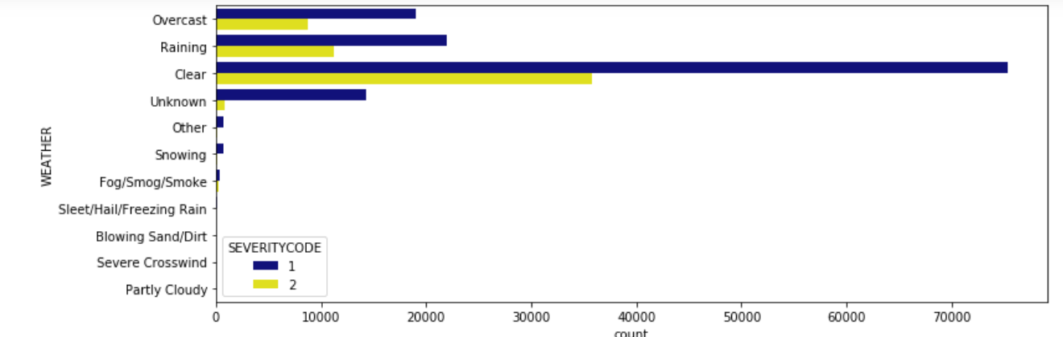
Using SEVERITYCODE as severity measure
Most collisions occur during the clear weather, daylight and dry roads
Most of the collisions are classified as property damages

Slide 5
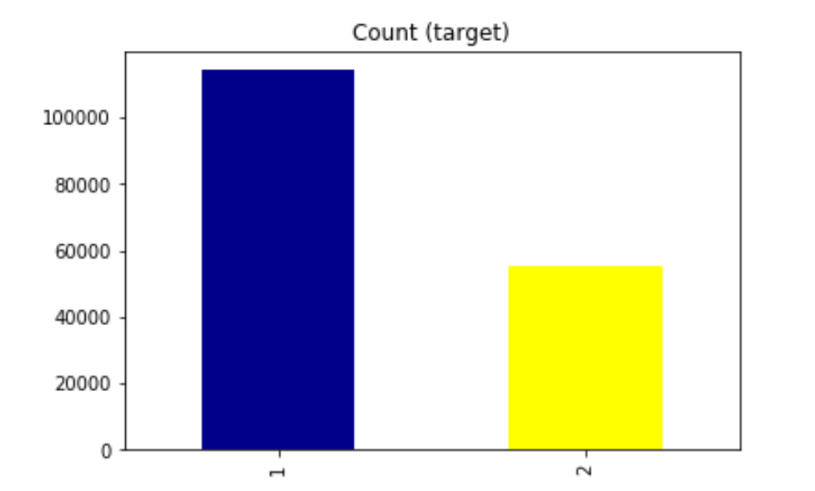
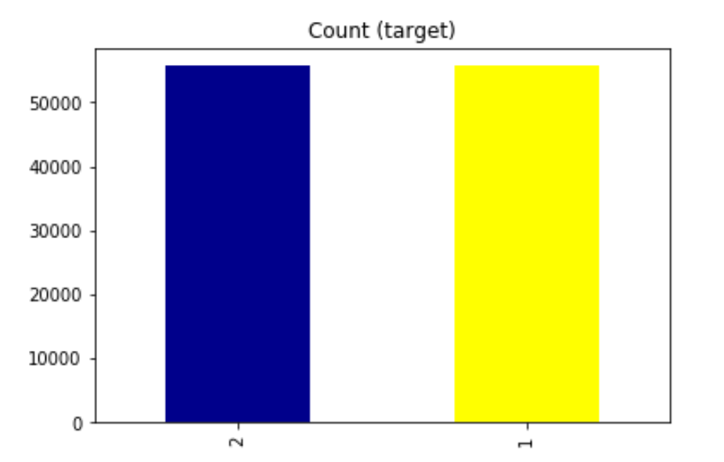
Dealing with unbalanced dataset
The data was unbalance by 43%, before cleaning and 49% after cleaning
Down sampling was used to balance the data

Slide 6
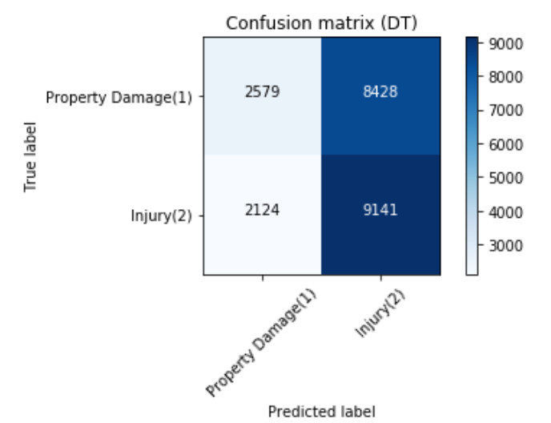
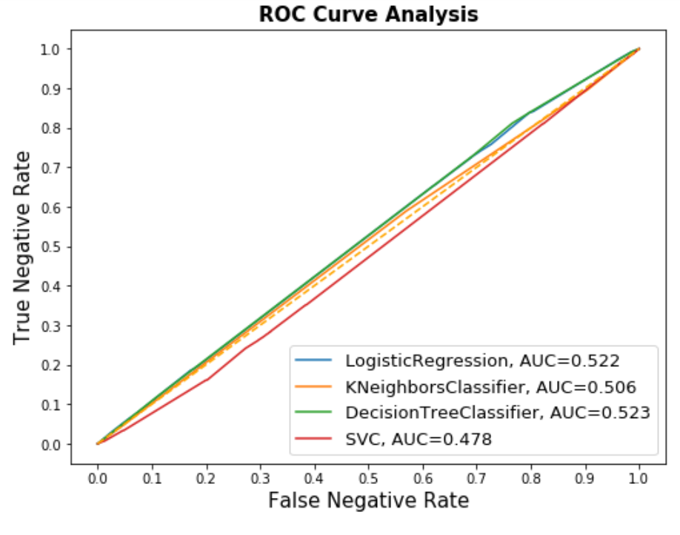
Classification models performance
F1-score:
0.4830-0.5075 between 4 models
Jaccard:
0.5106-0.5262 between 4 models
Decision Tree performed best among single algorithms

Slide 7
Conclusion and future directions
Built useful models to predict whether a driver will get into an accident and the severity of that accident.
Accuracy of the models has room for improvement.
Ideas include:
JUNCTIONTYPE
ADDTYPE
Displaying the location of the accidents on map (longitude, latitude)
A description of the collision (whether it was a vehicle to vehicle or vehicle to bike accident)

